Slide 1
Presentation ON Polymorphism in C++

Slide 2
Polymorphism in C++
The word polymorphism means having many forms.
Polymorphism is considered as one of the important features of Object Oriented Programming.
In simple words, we can define polymorphism as the ability of a message to be displayed in more than one form.

Slide 3
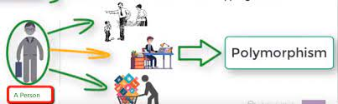
Example of Polymorphism
A person at the same time can have different characteristics. Like a man at the same time is a father, a husband, an employee. So the same person posses different behavior in different situations. This is called polymorphism.

Slide 4
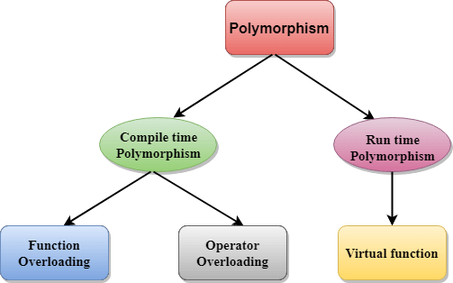
Types of Polymorphism

Slide 5
Compile time polymorphism
This type of polymorphism is achieved by function overloading or operator overloading.
function overloading.
operator overloading.

Slide 6
Function overloading
Function Overloading is defined as the process of having two or more function with the same name, but different in parameters is known as function overloading in C++.

Slide 7
Operator Overloading
You can redefine or overload most of the built-in operators available in C++.
Overloaded operators are functions with special names: the keyword "operator" followed by the symbol for the operator being defined

Slide 8
Run Time Polymorphism
This type of polymorphism is achieved by Function Overriding.
Function Overriding :-
If derived class defines same function as defined in its base class, it is known as function overriding in C++

Slide 9
virtual function
A virtual function is a member function which is declared within a base class and is re-defined(Overriden) by a derived class.
Functions are declared with a virtual keyword in base class.
The resolving of function call is done at Run-time.

Slide 10
Thank
You
Download ppt’s and handwritten notes
JP Web devolpers
Follow on instagram:-@jpwebdevelopers

